Slide 1

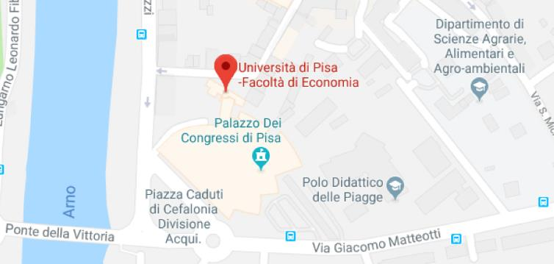



Economics and Management
DIPARTIMENTO
DI ECONOMIA E MANAGEMENT
The Department of Economics and Management (DEM) is characterized by a highly multidisciplinary nature. DEM is involved in teaching, scientific research, applied research and post-graduate formation, in the economic, managerial and statistical-mathematical fields.

Slide 2
Department at a glance
97
Research staff
38
Graduate students
27 (3)
Technical and administrative staff (Research support staff)
12
Studies Programs
Publications N. 4746 Arpi 02/04/2019
Authored books/Book chapthers N. 1789
Arpi 02/04/2019
Articles N. 1908
Arpi 02/04/2019
Economics and Management

Slide 3
Research Areas
Area 1
Area 2
Area 3
Management, Strategy, Accounting, Corporate finance, Financial markets and institutions, Organizations and human resource, Public management, Accounting history.
Economics, economic policy, applied economics, public finance, econometrics, history of economic though, economic history
Statistics, economic statistics, social statistics, mathematical methods for economics and financial/actuarial sciences, demography.
Economics and Management

Slide 4
Research Projects
European commission
4 H2020
5 Erasmus + programme (Jean Monnet)
Ministry funded projects
5 PRIN
Other projects
1 MIT-UniPisa
1 National Erasmus + agency and INDIRE
1 Grant RSA MeRSA
1 Project Fondazione Finanza Etica
Economics and Management

Slide 5
Research Impact:
Applied research and consultancy for firms, public administration and industrial associations (€ 472.067 from 2012 to 2018)
Advanced education (I): 5 first level master’s diploma: Auditing Finance and Control, Balance sheet and administration, Marketing management, Risk management (in english)
Advanced education(II): 6 second level master’s diploma: Auditing and internal control, Auditing and risk management, Master for Chief financial Officer, Business administration and management, Finance and Management Control, Healthcare management.
Partecipation to research centers and labs: the Department of Economics and Management participates at 13 research centers/labs (CCD, CLAB, CICSE, CIRTHE, IRTHA, LES, MOVET, CIRN, REMARC, UCAR, WGGC,CIES, ESS) engaged in carrying out applied research for companies and other entities and in the dissemination of entrepreneurial culture
Economics and Management

