Slide 1



Intellectual property what is and how to use it in public research organizations PhD+ 2017 Research valorization, innovation, entrepreneurial mindset
Corrado Borsano
Pisa, May 4th , 2017
www.metroconsult.it

Slide 2

Metroconsult
Founded in 1987, Metroconsult supports its clients by protecting and monetizing all aspects of their Intellectual Property (IP). Metroconsult believes that IP is a critical asset that must be protected and maximized in value.
With its dedicated team of IP professionals, the company offers high quality services worldwide. These services include drafting, filing, prosecution, opposition of patent, trademark, copyright, design and domain name.
Metroconsult’s goal is to provide comprehensive and tailored assistance to its clients with confidentiality , professionality and expertise.

Slide 3
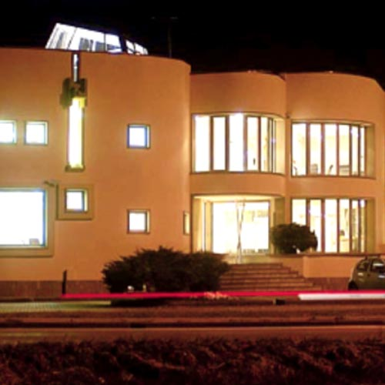
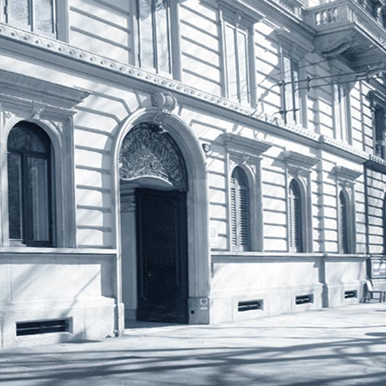
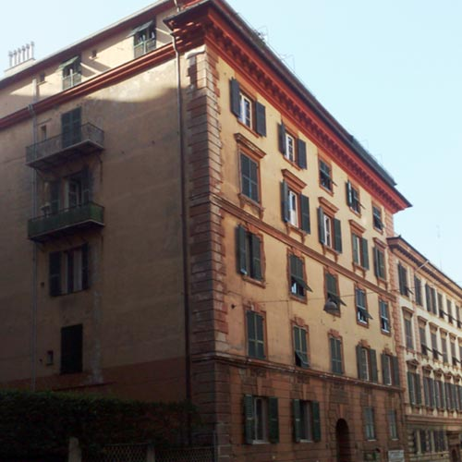
Offices
Torino None - Via Sestriere 100 Tel +39 011 9904174 Fax +39 011 9904182
Milano Foro Buonaparte, 51 Tel +39 02 36720300 Fax +39 02 36720301
Genova Via Palestro, 5 Tel +39 010 8196592 Fax +39 010 8601055

Slide 4
Services
Metroconsult offers all around the world a wide range of high quality services and tailored solutions to maximize the value of IP Rights.
Patents and Utility Models
Trademarks, Design, Domain Names
Copyright
Software
Documentation Research
Market Surveillance
Legal Consultancy
IP Valuation

Slide 5
Approach, philophy & values
Services tailored to client’s requirements
Industrial background
Our clients can rely on our:
Confidentiality (under all aspects and in compliance with different international legislations)
Integrity (our policy is not to have more than one client in the same field)
Availability (24/7)

Slide 6
HIGHLY QUALIFIED PROFESSIONALS
All our IP professionals are chartered attorneys at the Italian and International level
Strong contribution to articles in Italian and international IP magazines (such as INTA Bulletin, MIP, WTR)
Members of relevant international associations (INTA, ECTA, LES, AIPPI, MARQUES, INDICAM)
Always present at major conventions with booths and hospitality suites

Slide 7
Contents
Strategic considerations about Intellectual Property / Patents
Getting a valuable patent

Slide 8
Intellectual Property
Legal
Technical
Intellectual
Property
Business

Slide 9
Intellectual Property
Immaterial assets - Product-unrelated property
PATENTS
MODELS, DESIGNS
TRADEMARKS
COPYRIGHT (SOFTWARE)
KNOW-HOW

Slide 10
Know-how
KNOW-HOW
CONFIDENTIALITY
Know-how is an important asset
but only as long as it is confidential
It must remain property
It may be disclosed to third parties only under:
Non-disclosure agreement
License agreement with confidentiality clause
Other agreements “ “ “

Slide 11
NEED TO PROTECT IPRs BEFORE ANY DISCLOSURE
RISKY SITUATIONS:
Publications
First selling
Field trials
Exhibitions, trade fairs
Oral disclosure, talks with customers or suppliers
Works in the standardization committees

Slide 12
Disclosure
Non-disclosure agreements
Sign before any disclosure of know-how, software
N.B.: NDA is valid only against the other party
Legal issues to be solved in advance
Patents
File before any disclosure
Validity against any third party

Slide 14
What a Patent Is
Legally:
Right to forbid a special technical solution
Registered with authorities
Limited in time and territory
Technically:
Description of a technical solution
Commercially:
Commercial tool vis-à-vis competitors

Slide 15
Patentability
What can be patented
Products
Features
Processes
Systems
New use
whether realised as hardware or as software

Slide 16
Criteria for Patentability
Novelty
Not known to the public
Small difference is decisive
Non-obviousness (inventive step)
To be judged in comparison with prior art
A question for patent experts only
- you should never decide this question for yourself
Industrial application

Slide 17
Commercial Value
Competitor’s interest
Sole value
Sole value: competitor’s interest in its use
No need for a patent for own use
Exists when
Market requires a first solution: “Basic Patent”
Market requires new features
No equally satisfactory solutions

Slide 18
Commercial Value
Software protection
Patent = most effective level of protection
Protection of the concept
Technical solution to a technical problem
Not only the form of expression (Copyright)
Problems
Identification basic idea
Infringement detection
decompilation is not allowed

Slide 19
Commercial value
Required geographical coverage
Location of competitors/markets
National Patent Application
European Patent Application
International Patent Application
Lifetime cycle of product
Patent: ~20 years

Slide 20
Commercial Value
Provability of patent infringement
Reverse engineering
Competitor product analysis
Input/output analysis
Hardware acquisition and analysis
Technical product manuals
Inspect information
Conferences and scientific publications
Exhibitions, Marketing studies

Slide 21
Patent Strategy
Aggressive
Forbid
Offensive
Give licenses
Defensive
Exchange licences

Slide 22
Patent Strategy
Aggressive use
Action:
Forbid exploitation of a technical solution
Targets:
Monopolise the market
Achieve market place objectives
Examples:
Pharmaceutical products

Slide 23
Patent Strategy
Offensive use
Action:
Detect infringement of our own patents
Do not allow unauthorised (without license) use
Targets:
Improve bargaining position in commercial activities
Keep know-how licensees under better control

Slide 24
Patent Strategy
Offensive use
Obtain commercial benefit whenever we wish, accept or have to:
Wish: return from market we are not in, control licensee
Accept: settlement of infringement
Have to: compulsive license, standards
Impose restrictions on licensee which are otherwise not permitted:
EU competition rules

Slide 25
Patent Strategy
Defensive use
Action:
Agree with competitors on mutual use of patents
Cross license agreements
Targets:
Design freedom

Slide 26
Standards & Patents
ANSI
Invention
Patent
Standard

Slide 27
Commercial Value
Standard-related invention
Gold value chain
Use of an “Essential Patent” becomes a must
Use of an “Essential Patent” is not royalty-free
Standard compliant equipment infringes
ANSI
Invention
Patent
Standard

Slide 28
Standards & Patents
Conflicting approaches:
IPR: right to forbid/allow
Standards: ensure that a solution is available
“Essential Patents” are the most important ones:
Use of “Essential Patent” becomes a must
Use of “Essential Patent” not royalty-free
Standard compliance = infringement

Slide 29
IP is a competitive tool for a company’s growth
IP Financing
Leverage
the IP Value
IP Protection
yesterday today
Today, Intellectual Property is representing an important tool for economic growth and corporate financing

Slide 30
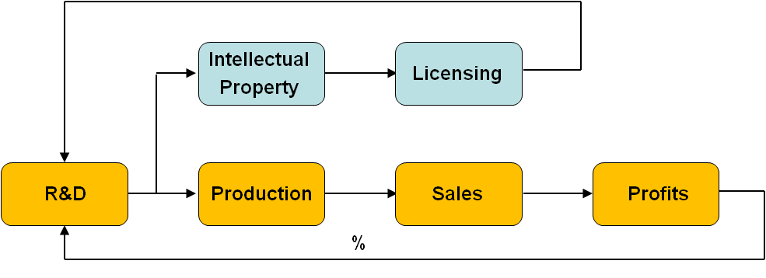
Companies financing R&D expences with licensing revenue
Inventive Loop
30

Slide 31
UNIVERSITY
Basic research invention or discovery
(the direct industrial application
may not be possible, therefore
not patentable)
Applied research
internal development start-up /spin-off creation
joint development with IP results usable for
other entities licensing/selling
Applied research IP results property
financed by industry of the industry
only and anyway ?

Slide 32
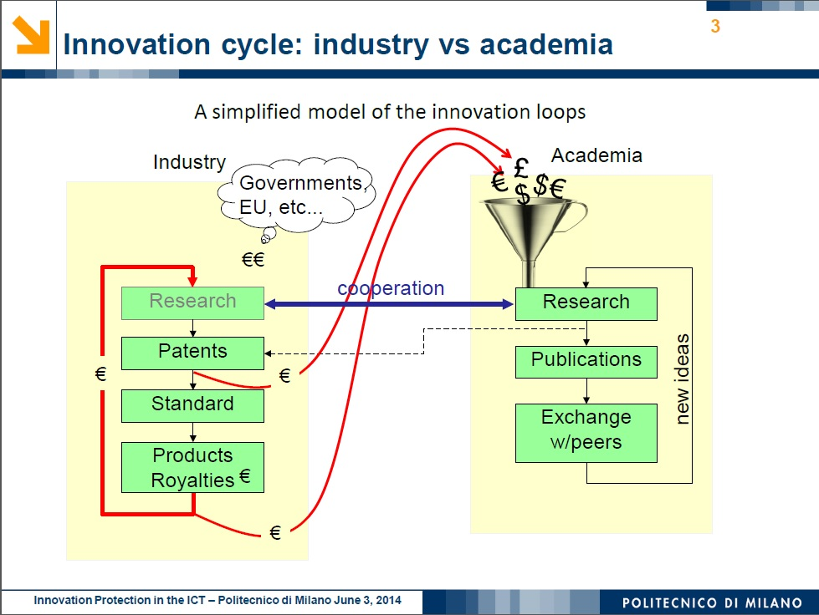

Slide 33
GETTING
A VALUABLE
PATENT

Slide 34
Drafting of a Patent application for first filing
Business considerations
Inventor(s)
Patent
Attorney
Legal
considerations

Slide 35
Drafting of a Patent application for first filing
Tasks of the
Patent
Attorney
-------
Major effort
focused on
patent
application
.
.
(others ?)
.
Tasks of the
Inventor(s)
-------
Major effort
focused on
technical
description
.
.
(others ?)
.
driver

Slide 36
Criteria for Patentability
Do not think or believe by yourselves:
lack of novelty
lack of inventive step
When somebody says:
“What everybody does”
“What you just have to do”
those are sometimes the best patents
Fill in an Invention Disclosure Form and submit it to the correct person inside your Organization for evaluation

Slide 37
Criteria for Patentability
Novelty
Not known to the public
Small difference is decisive
Non-obviousness (inventive step)
To be judged in comparison with prior art
A question for patent experts only
- you should never decide this question for yourself
Industrial application

Slide 38
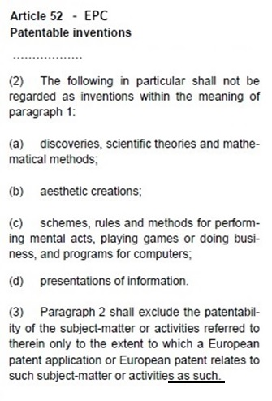
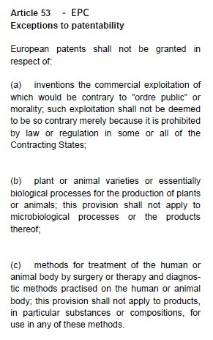
Criteria for Patentability: what cannot be patented
European
Patent
Convention
Equivalent
Provisions in
the Italian
Patent law
38

Slide 39
Problem-Solution Approach
Is there a technical problem to be solved?
Is there a deficiency in the known solutions
rendering them useless to the purpose?
Is there a basic idea
for solving the technical problem
In a non obvious way vis-à-vis the known solutions ?
TECHNICAL SOLUTION TECHNICAL EFFECT

Slide 40
The simpler the basic idea The higher its value
The more the basic idea can The higher its value
be easily identified (with respect
to the rest of the project)
The same considerations apply to the SOFTWARE INVENTIONS when the software can be considered as a means for the embodiment of the invention
The software is patentable in the technical results and not per se («as such»)

Slide 41
What is «Technical»?
There is no definition of the term “technical” in the patent law, as it is extremely difficult to find a definition which might be valid for all the technology fields and that might be valid also in the future.
Thus, reference must be made to the EPO Case Law containing the decisions taken by the Board of Appeals.
Examples of what is considered technical (software domain):
processing physical data in a system which affects the control of an industrial process;
processing which affects the way in which a computer operates such as a file compression algorithm;
any physical apparatus such as a computer or any of its components are considered to be technical.

Slide 42
What is «not-Technical»?
Purely abstract concepts are considered as non-technical.
Examples of what is considered to be non-technical (software domain):
sales methods, trading, insurance schemes;
business administration acts (choosing a candidate for a job);
modeling a system;
mathematical methods describing the physical effects of an electronic filter.
In other words, the activities falling within the frame of the “non inventions” tipically represent abstract concepts devoid of any technical implication.

Slide 43
Software Protection
Types of legal protection for software
Copyright
Only the form = the sequence of instructions
No protection of idea, procedure, process, system
Trade Secret
Disclosure only with confidentiality obligation
Patent
Most effective level for protection of software
Entire inventive concept is protected

Slide 44
Invention Study
IDF submission
Inventors
Filing Decision
Decision
Organization
First Filing
Inventors,
Patent Attorney
Further Filing
Decision
Organization

Slide 45
When filing a patent application
When first filing ?
Before any disclosure
Internally Esternally
Keep confidential
Decision on filing
Disclosure possible
Decisions on further filing and how to use the patent
t
Generating invention Getting patent
Filing date
of the first application

Slide 46
Decision on country coverage
Countries of manufacturing by the owner or his licensees;
Countries of manufacturing by the major competitors or their licensees;
Countries of direct or indirect selling by the owner and/or competitors;
Countries where licensing opportunities can happen;
Balance between costs/benefits in each country.

Slide 47
Country coverage decision procedure (example)
Further filing
(national/regional)
USPTO
CN
JPO
EPO
DE
….
….
UK
DE
….
First national filing
(i.e. Italian)
USPTO
CN
JPO
EPO
FR
….
….
UK
DE
FR
Get preliminary
opinion on
patentability
PCT
1 year
National/regional phase after PCT
30/31 months

Slide 48
Rule 42 EPC Content of the description
The description shall:
specify the technical field to which the invention relates;
indicate the background art which, as far as is known to the applicant, can be regarded as useful to understand the invention, draw up the European search report and examine the European patent application, and, preferably, cite the documents reflecting such art;
disclose the invention, as claimed, in such terms that the technical problem, even if not expressly stated as such, and its solution can be understood, and state any advantageous effects of the invention with reference to the background art;
briefly describe the figures in the drawings, if any;
describe in detail at least one way of carrying out the invention claimed, using examples where appropriate and referring to the drawings, if any;
[...]

Slide 49
Problems
Drafting of a patent application must keep into account, since the beginning,
the real targets the granted patent will have:
at the time of its economic exploitation;
kinds of potential target users of the invention;
… other factors (in)dependent of the intrinsic technical value of the invention;
with the purpose to get the best protection vis-à-vis the target users.

Slide 50
The quality of a patent (application) starts with a comprehensive search for prior art
It is important to perform a prior art search before drafting a patent application
A prior art document cited in the introductory part of the application is potentially less dangerous with respect to the possibility that this document will be used against the patent (application) in the examination procedure or in a Court litigation.
In fact citing it in the patent application allows to explain why this document is not pertinent to the invention.

Slide 51
Further advantages of a preliminary search for prior art
This search allows to:
Avoid using technical solutions subject of valid patents held by competitors;
Avoid spending useless efforts in the design of technical solutions already known in the relating art.

Slide 52
Prior art search An advantage for the Italian patent applications
By an agreement with the Italian patent office, the European Patent Office performs a search for prior art and a preliminary opinion on patentability for any new Italian patent applications.
This is a toll-free tool (payed by the Italian PTO) available before the end of the 1 year priority period, therefore very useful for helping deciding on the further filing of the application abroad.
In addition it is possible to have a partial reibursement of this fee in case of further filing a European or PCT application, to the extent that this search is also used in those proceedings.

Slide 53
Preliminary evaluation of the state of the art
PRIOR ART SEARCH
Generation of own IPRs
Patentability evaluation
Use of third parties IPRs
Freedom to operate
evaluation
1)
2)

Slide 54


A correct procedure
Designing/
Prototyping:
Start - end
Patent state of the art
analysis
Market evaluation of existing similar products
Possible patent application
Start selling/using on the market
RISK ASSESSMENT for USE OF THIRD PARTIES IPRs AVAILABLE
TECHNICAL INFORMATION on THIRD PARTIES IPRs AVAILABLE
CORRECT PROTECTION of OWN IPRs
agreements with third parties IPRS owners

Slide 55
Patent Application
Introduction
Description
Claims
Abstract
Figures
- Closest prior art
- Problem
- Object
- Essential feat.
- Effect
- Other features
- Embodiment
- Independent
- Dependent
- Abstract
Patent application

Slide 56
Essential elements of a patent application
One invention only
Various aspects of a complex invention linked by a unifying concept
Title
Description
It must allow a technical expert to implement the invention correctly, without performing further undue technical efforts, applying only his technical background knowledge
Claims
Defining the wanted scope of legal patent protection in terms of technical features
Drawings
Generally necessary for the understanding of the description

Slide 57
The function of the description
The task of the description is to demonstrate that at least one embodiment example of the invention is feasible.
It is important to include in the part of the description all the necessary details for the correct technical understanding, if necessary with the help of drawings.
An insufficient description can put the validity of the patent at risk , also after granting, with a possible nullity action, and cannot be recovered after filing, as the application cannot be improved with added matter later.

Slide 58
Criteria in USA Some differences with respect to Europe
Usefulness (Utility Patent)
Enabling disclosure (very detailed embodiment examples needed)
Best mode description (obligation to not deliberately describe non optimal embodiments)

Slide 59
The function of the claims
The claims must satisfy two requirements:
The Owner willingness to include in his exclusive right as much as possible of the contents of the patent;
The third party right to understand as much as possible the real «boundaries» of the owner rights granted.

Slide 60
Importance of the claims
The claim drafting is the most complicated and challenging part of the professional activity of patent application «building up» by the Patent Attorney
The Patent Attorney must consider not only the level of protection according to the state of the art at the time of drafting, but he must also foresee, as much as possible, the future trends of the related technology, as the patent life can be up to 20 years; the competitors will try to design around for the full patent life possibly using new technologies and knowledges, to avoid using that patent.

Slide 61
Rule 43 EPC
Form and Content of Claims
The claims shall define the matter for which protection is sought in terms of the technical features of the invention.

Slide 62
Different kinds of claims
Optimization of the protection
Matching patent claims with product features
Different kinds of claims address different kinds of patent users
Typically:
Apparatus claims address manufacturers / sellers of the whole system or parts of it
Method claims address the users of the system or parts of it

Slide 63
Guidelines EPO (1) Kind of claims
The EP Convention refers to different "categories" of claim
("products, process, apparatus or use").
……………………………………..
there are only two basic kinds of claim
claims to a physical entity (product, apparatus)
and
claims to an activity (process, use).

Slide 64
Guidelines EPO (2) Kind of claims
The first basic kind of claim ("product claim") includes:
a substance or compositions (e.g. chemical compound or a mixture of compounds) as well as
any physical entity (e.g. object, article, apparatus, machine, or system of co-operating apparatus) which is produced by man's technical skill.
The second basic kind of claim ("process claim") is applicable to:
all kinds of activities in which the use of some material product for effecting the process is implied (also software inventions);
the activity may be exercised upon material products, upon energy, upon other processes (as in control processes), (also software inventions).

Slide 65
Different kinds of claims Kinds of EP claims for software protection
Method ….. (sequence of steps of the main flow-chart)
Device or apparatus…… (list of means for implementing the steps of the method)
N. Computer program comprising computer program code means adapted to perform all the steps of claim ... when said program is run on a computer.
N+1. A computer readable medium having a program recorded thereon, said computer readable medium comprising computer program code means adapted to perform all the steps of claim ... when said program is run on a computer.

Slide 66
Patent claims
Kinds of claims
For every invention it is necessary to check if it possible to insert in the patent application claims to:
a method
a system
each part of the system (if it can be divided in sub-systems)
each apparatus / device comprised in the system
i.e. transmitter and receiver in a transmission system
computer program
Each claim must be related to the potential user / infringer
The users / infringers may be different for different kinds of claims

Slide 67
Thank you for your attention!
ing. Corrado Borsano
corrado.borsano@metroconsult.it
www.metroconsult.it

Slide 68


