Slide 1
ERASMUS
Staff Week 2017
Introduction to Friedrich-Alexander-University of Erlangen-Nueremberg (FAU)
Advance through networks
Dr. Bianca Distler
Pisa, 19-06-2017
Notes:
- what does FAU stands for/represent
-facts and figures
- internationalisation
- cooperate bachelor degree programs
- our student counselling service

Slide 2
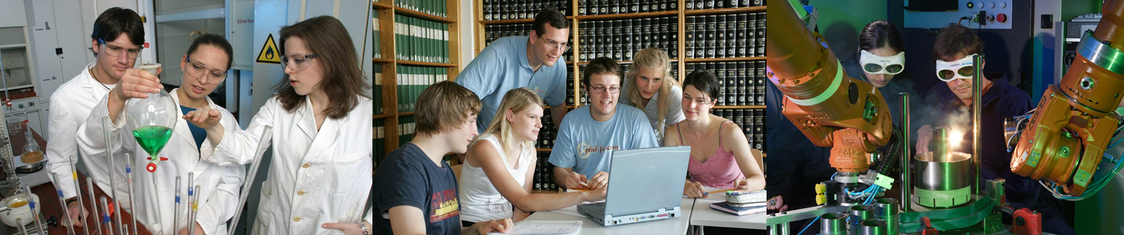
FAU – one of the leading research universities in Germany
5 faculties (incl. Faculty of Engineering and university hospital)
23 departments, 25 clinics
More than 256 degree programs, among them 78 Bachelor’s degree programs and 90 Master’s degree programs; 90 State Examination degrees
Round 40.000 students (WS 2017/18), of which 4.400 international students
approx. 13.000 staff, of which 647 professors

Slide 3


Reykjavik
Oslo
Helsinki
Stockholm
Moscow
Dublin
Warsaw
London
Prag
Bratislava
Paris
Budapest
Bukarest
Sofia
Madrid
Rome
Ankara
Lissabon
Athens

Slide 4
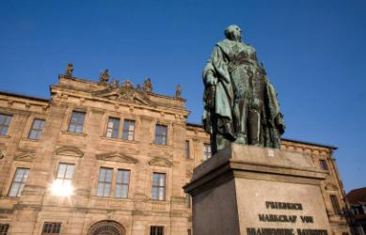
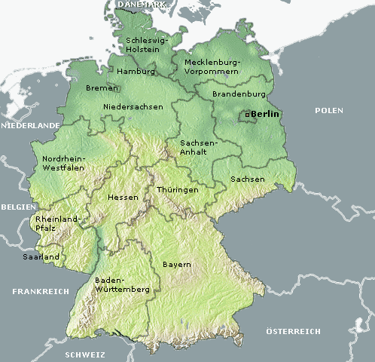
The University of Erlangen-Nürnberg (FAU) – at the heart of Europe
Bamberg
Erlangen
Main sites
Erlangen [>100,000 inhabitants]
Nürnberg [> 500,000 inhabitants]
Other sites
Bamberg Astronomical Institute of the FAU
Fürth Institute of Advanced Materials and Processes
Pleinfeld Water sports centre
Ingolstadt INI.FAU Ingolstadt Institute
Affiliated institutes
Max-Planck Institute [in Erlangen]
Fraunhofer Institutes [two in Erlangen]
Fürth
Nürnberg
Pleinfeld
Ingolstadt
Source: FAU
Notes:
Erlangen and Nürnbergin the European Metropolitan Region Nürnberg = 3.5 million inhabitants
Bavaria:12.5 million inhabitants

Slide 5
Structure of FAU
University Council
8 elected senatores
8 external members
Senate
FAU Executive Board
President
Chancelor
Vice President for International Affairs
Vice President for Research
Vice President for Teaching
University Governing Board (FAU Executive Board and Deans of the 5 Faculties)
5 Faculties
Humanities and Dep. Theology
Appr. 10.000 students
Business, Economics, and Law
Appr. 8.000 students
Medicine
Appr. 3.000 students
Sciences
Appr. 5.500 students
Engineering
Appr. 9.000 students

Slide 6

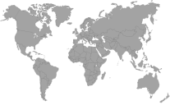
International Network
FAU in total
602 cooperations with 497 universities
in 80 countries
Faculty of Engineering | Faculty of Science | Faculty of Business, Economics and Law | Faculty of Humanities, Social Sciences and School of Theology | Faculty of Medicine
310 cooperations | 212 cooperations | 243 cooperations | 250 cooperations | 160 cooperations
in 62 countries | in 61 countries | in 61 countries | in 66 countries | in 63 countries
Europe 149 cooperations in 29 countries (i.e.. France 19, Russia 16, Spain 14, Italy 14, UK 12)
Asia 61 cooperations in 21 countries (i.e.. Japan 12, China 8, India 8, Korea 7)
South America 22 cooperations in 7 countries (i.e.. Brazil 10, Chile 4, Argentina 4)
Central America 6 cooperations in 2 countries (Mexico 5, Costa Rica 1)
North America 68 cooperations in 2 countries (USA 47, Canada 21)
Oceania 2 cooperations in Australia

Slide 7

1743 FAU founded by Margrave
Friedrich of Bayreuth
1769 The name of the
University is changed to mark
Margrave Alexander of
Ansbach and Bayreuth’s patronage:
Friedrich-Alexander-Universität
Erlangen-Nürnberg
History

Slide 8
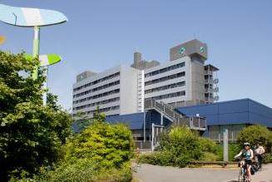
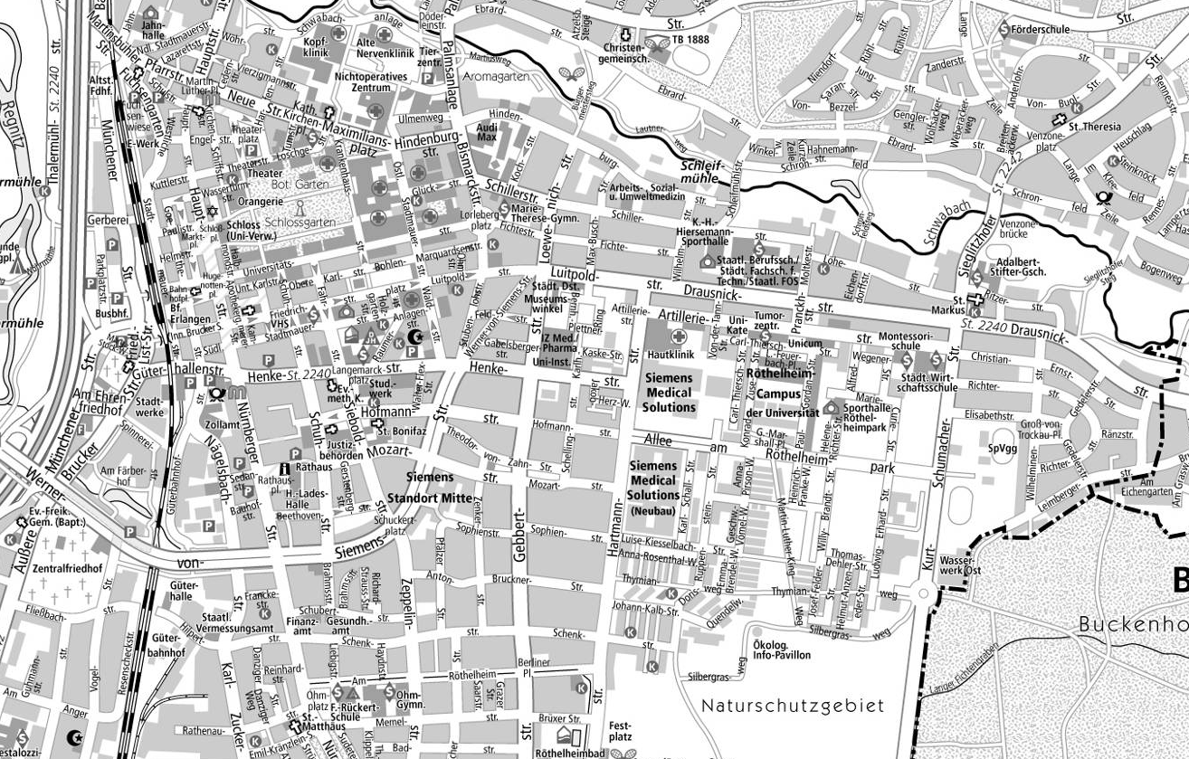
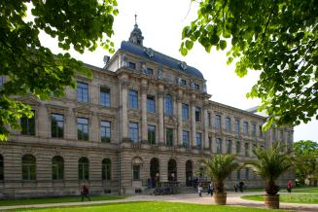
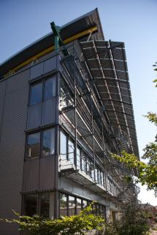
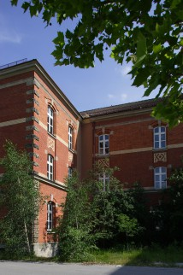
The University in Erlangen – Campus City Centre
Locations
Erlangen City Centre
Notes:
Distributed and allocated
The administration and canchellor are in downtown ☺, inner city
Among = zwischen, unter
Among experts = unter Fachkreisen

Slide 9
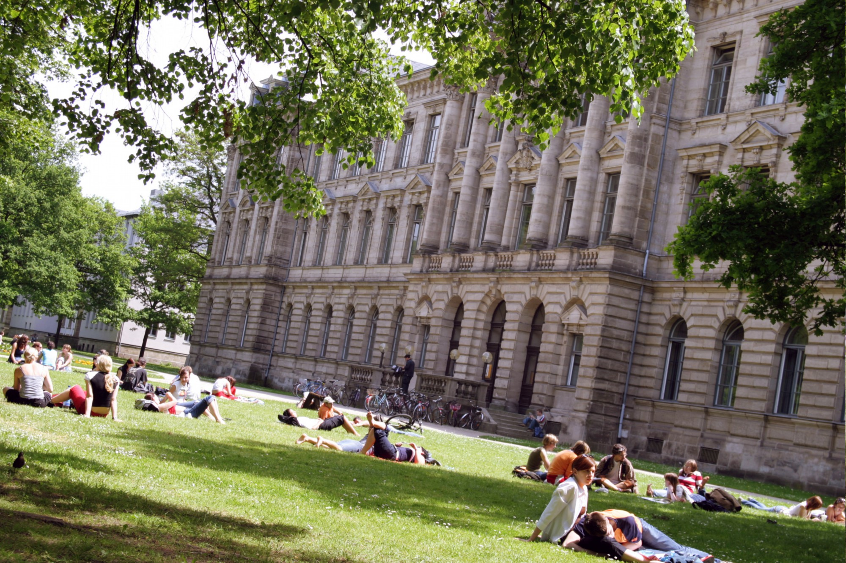
Notes:
The Schlossgarden - inner city

Slide 10
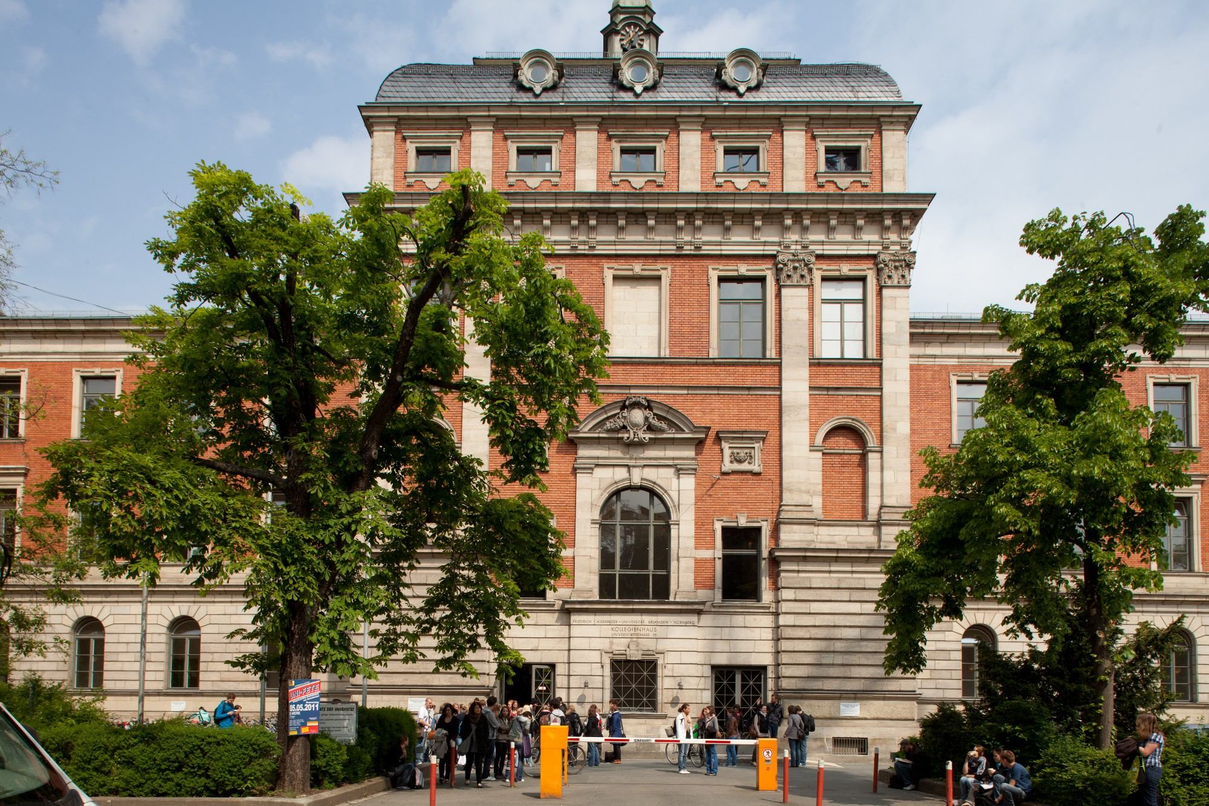
Notes:
Central Builiding with lecture hall, of the faculty of philosophy

Slide 11
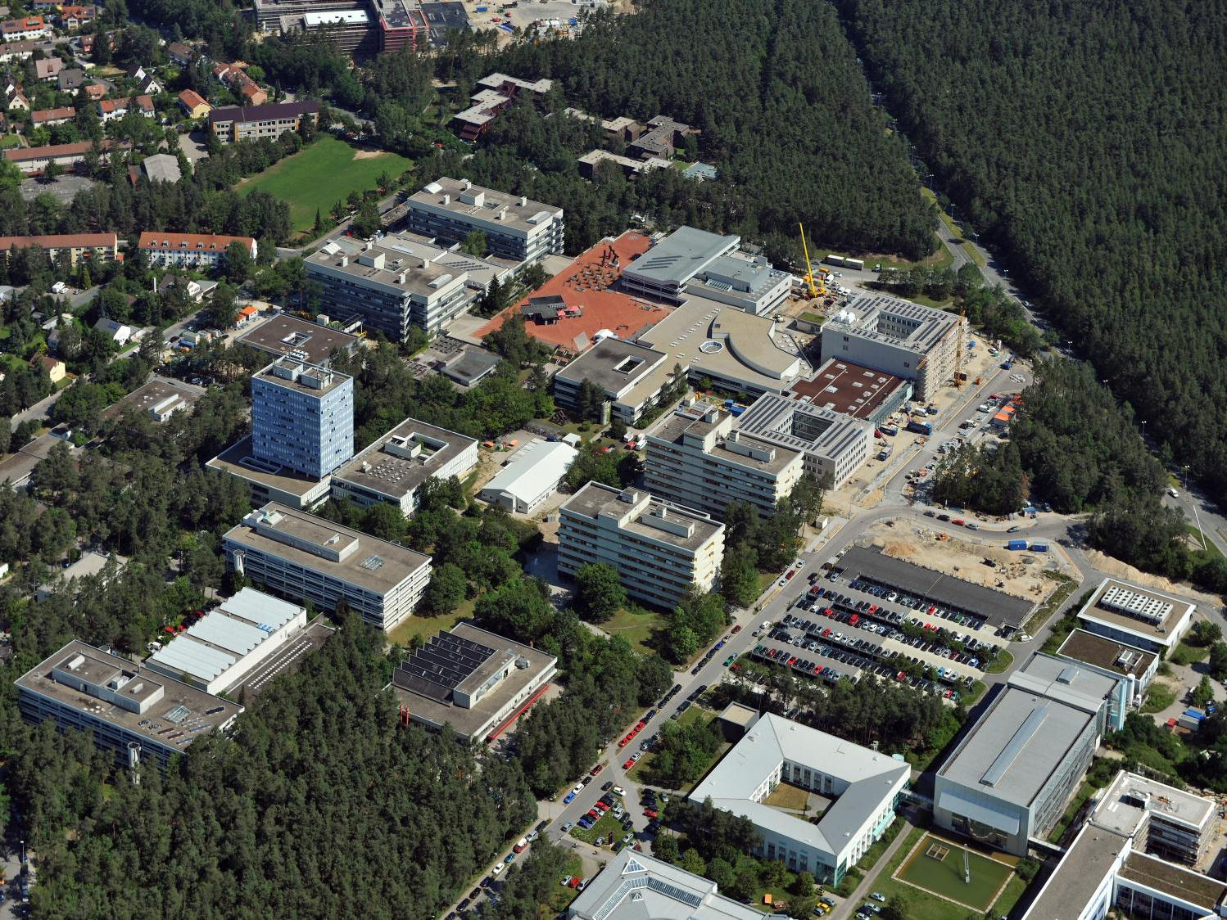
Notes:
Technical faculty

Slide 12
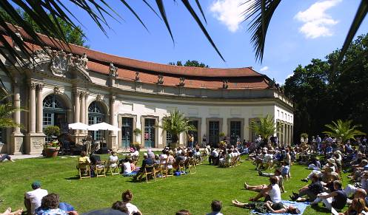
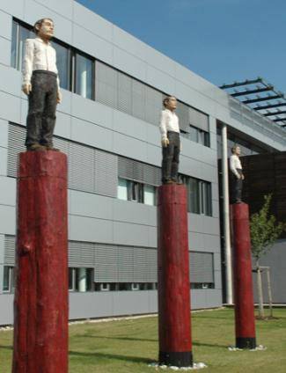
Erlangen – „savoir vivre“
The smallest of Bavaria‘s big cities (111.000 inhabitants) has preserved its international flair of the days of the Huguenots to this day.
The city is dominated by university buildings, university clinics and branch offices of SIEMENS. Erlangen has developed as the medical and high-tech center of the Nürnberg metropolian area.

Slide 13
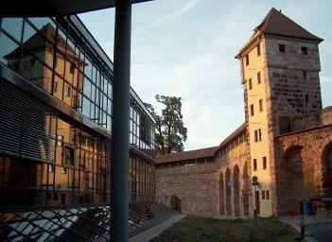
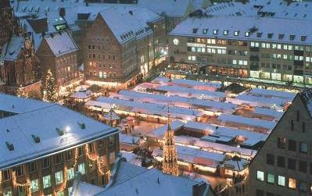
Nürnberg – Tradition and modern spirit
Even though Nürnberg is Bavaria‘s second largest city (appr. 500.000 inhabitants) , it has preserved its typical Franconian coziness. But the town today is also a cosmopolitan,
international, modern city.
You can experience this international appeal best during the annual Christkindles Christmas Market.

Slide 14
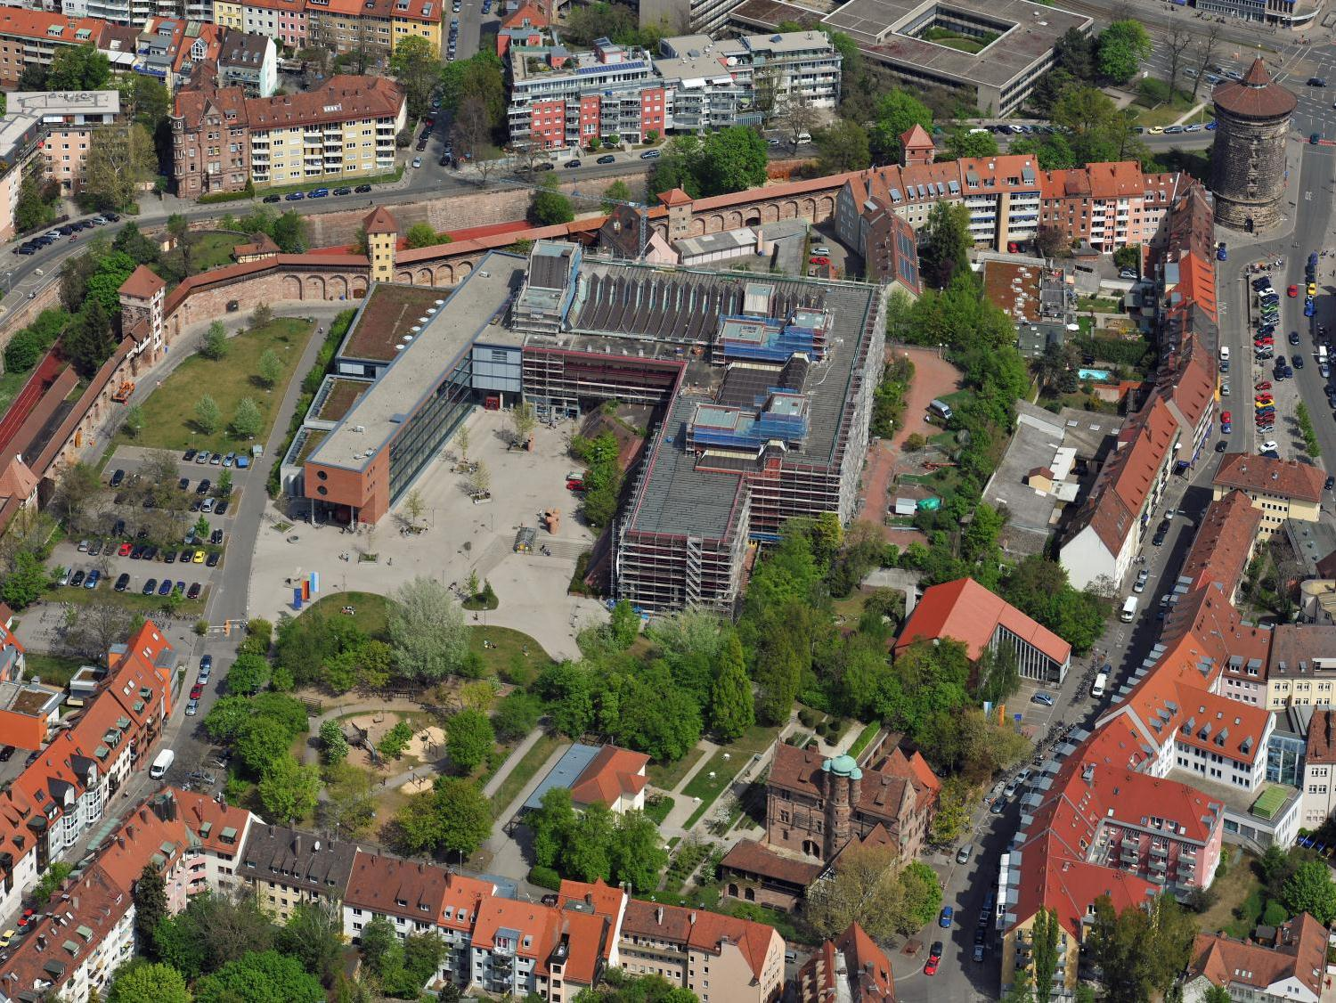

Slide 15
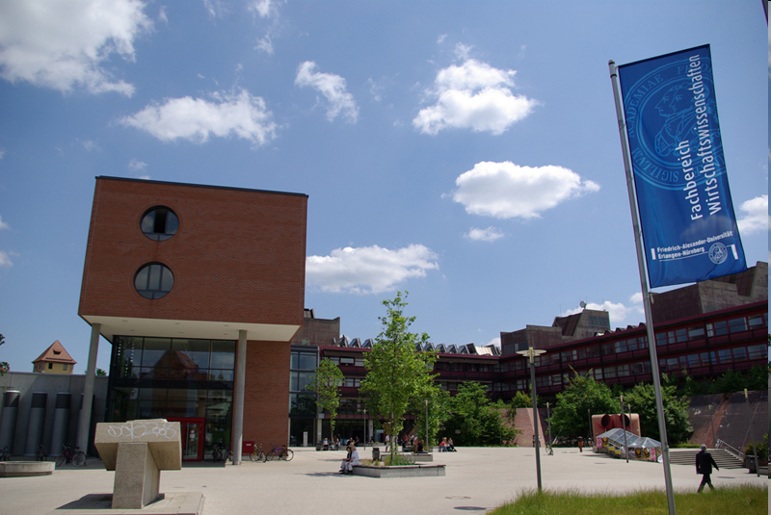

Slide 16
Our Major Research Areas
Research
Humanities, Social Sciences, and Theology | Business, Economics, and Law | Medicine | Sciences | Engineering
 |  |  | New Materials and Processes
 |  | Optics and Optical Technology
 |  | Molecular Life Science and Medicine
 |  | Health Technology
Electronics, Information and Communication
Energy, Environment and Climate
Language – Culture – Region
Cohesion – Transformation – Innovation in Law and Economics

Slide 17

Internationalization

Slide 18

International profile
About 500 partner universities in more than 70 countries
A high standing among international academics as confirmed by top positions in the Alexander von Humboldt Foundation rankings:
  Rank 6 in engineering, Rank 8 in natural sciences
More than 200 Humboldt scholars, among them
3 Humboldt professorships
FAU Language Centre among the largest in Germany
FAU Campus Busan (South Korea)
Bavarian University Center for Latin America (BAYLAT)
Confucius-Institute Nürnberg-Erlangen

Slide 19

Internationalization –
General Facts and Figures
25 Double Degrees in 15 degree programmes
About 4300 students from abroad, TOP 3 countries of origin: China, Turkey, Ukraine
44 international degree programmes, of which 13 taught entirely in English, 4 partly in English, 2 in other languages
About 70 employees from abroad among non-scientific staff
About 460 doctorate candidates from abroad
About 500 scientists from abroad

Slide 20
Internationalization - Bodies
Chancellor
Vice-President for International Affairs
Senate Commission for International Affairs
Central Office of International Affairs inc. Welcome Center
International Offices in the Faculties of Humanities, Medicine, Engineering, Sciences and in the Department of Law and Department of Economic Sciences
ERASMUS Co-ordinators in the Departments

Slide 21
Central Office of International Affairs - Tasks
co-ordination of all international contacts
elaboration of the international strategy of the university (in co-operation with the Vice-President for International Affairs)
dissemination of the university’s profile in teaching and research abroad (in co-operation with the Division of Marketing)
handling of exchange contracts
Notes:
Central Office of International Affairs - Structure
Head - Mobility Team Europe - Mobility Team Overseas - Accommodation service for Exchange Students - Welcome Centre for international Researchers and PhD Students - Advisor for regular students - Refugee Project (INTEGRA) Team

Slide 22

Service Units for regular international applicants
Admissions Office
Student Advice and Career Service
Graduate School

Slide 23
At FAU: Student advice and career service
Make the right decision ☺
Study Accompanying Advice
…and more: consulting foreign students, information days,
Source: FAU
17.06.2017
23
Notes:
FAU offers a vast selection of degree programmes and subject combinations. At first, this may be confusing, but don’t worry, the central Student Advice and Career Service is there to help you with all queries. Whether you would like to know how and when to apply, what is required of you for the degree programme you have chosen or what you will have to expect regarding examinations – we will help you find the answers to all of these questions. Of course, you can also come and see us if you have any problems during your studies, if you want to change subject or if you are struggling to cope with what is required of you. Just come by, we will help you make the right decision.
Advising Incoming students
Advising/ support on administrative as well as on personal level
Intermediary between home university, FAU faculty and student
Organisation of appointments at the foreigner‘s office in Erlangen
Consultation in case of personal problems, health issues, acommodation difficulties, communication problems.
Providing information on events, formalities before departure etc.
-Drop-in sessions
-Individual consultation
-Career Service
Please read our information sheets regarding the questions you may have carefully. This will enable us to help you even quicker and more effectively.
SEE HERE: https://www.fau.eu/2017/05/05/news/video-help-for-those-in-need-of-advice/

Slide 24

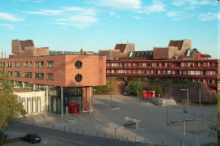

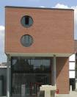
At a glance –
our Faculty of Business & Economics

Slide 25
School of Business and Economics
Bachelor courses – Bachelor of Arts
Business
Sciences
with the main focus on
International
Business
Studies (IBS)
Social
economics
with the main focus on
Business administration
Economics
Information management
Education and economics
Behavioural Sciences
International
Notes:
25

Slide 26
Introductory course – School of Business & Economics
1. Obligatory topics
Overview and method. basics
Introduction in BA, Econ. and Law
2. Key qualifications
Languages
Ability to create and hold presentations
Ability to work scientifically
3. Core area
dependent on main focus
within the main focus the same and
obligatory for all students
Introductory Course - Content
4. Area of Specialisation
four blocks
Arbitrary from the offered courses
5. Bachelor thesis
from the main focus
9 weeks
as the case may be
18 weeks for the thesis/practical work
Notes:
26

Slide 27

Introductory courses – School of Business & Economics
Assessment-Stage:
  Overview & Basics
  Introduction in BA, Economics, Law
Bachelor-Stage:
  Choice of the main focus
  Key qualifications
Course Year
4+5
Master-Courses
Profession
2+3
Degree Bachelor of Arts
1
Assessment Phase
Notes:
27
MASTER programmes:
Labour Market and Human Resources
(Doctoral) Master of Science in Economics
Finance, Auditing, Controlling, Taxation
(FACT)
International Business Studies (MIBS)
International Information Systems (IIS)
Management
Marketing
Socio-Economics
Business Education

Slide 28
Co-operative Bachelor's degree programme at FAU

Slide 29
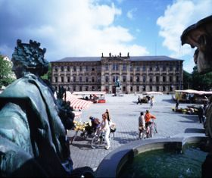

Definition – co-operative programme
Co-operative Bachelor's degree programme
- incorporates professional training/work experience:
in-depth practical elements
provided through training at a company
- two qualifications: university Bachelor's degree +
professional training qualification (3.5–4.5 years)
- co-operative degree programme students

Slide 30
Concept and implementation
Framework contracts with
IHK – Nuremberg Chamber of Commerce and Industry
and HWK Mittelfranken
flexible co-operation model:
professional training qualification and university degree (Bachelor's degree)
combination of over 70 Bachelor's degree programmes &
around 200 professional training qualifications from IHK (170 from HWK)
formal guidelines provided in
    framework contract between FAU and IHK/HWK
    degree programme examination regulations
    training contract (possibly educational contract)
does not have a separate study plan – same content and examination periods
Notes:
The transfer of credits earned abroad depends on whether they are equivalent to the requirements of the specific module in the German degree in terms of content.
The responsibility for the degree programmes which finish with a state exam (e.g. medicine, dentistry, pharmacy, law) lies with the State Exam Offices.
The responsibility of all other degree programes lie with the Examination Board of the specific degree at FAU. Each Department has its own procedure for credit transfer.
According to EU Law and Bologna requirements, the university must elaborately justify if and why they can not regognize grades from a study abroad period.
Admission requirements, duration and structure
at least a subject-specific university entrance qualification (FOS 13 or higher); good to very good grades
total duration of 4 years (3.5–4.5 years according to individual programme)
choice of 3 block models (→ 4th model available for HWK programmes)
good organisational and time management skills
Joint certificate awarded by FAU & IHK/HWK/StBK
in accordance with the co-operation contract which confirms additional results of training and university study
and overall grade
Costs
no additional costs for the University (other than providing the certificate)
administrative fees for co-operative degree programme students currently 42 euros

Slide 31
Question: How should incoming and outgoing students be supported?
1. Short exchange of suggestions
2. FAU examples

Slide 32
During Exchange – Outgoing Students
Students are within the responsibility of the hosting institution
Continuous support and guidance from home institution
To do for FAU: Elaborate emergency communication plan and create emergency response team

Slide 33
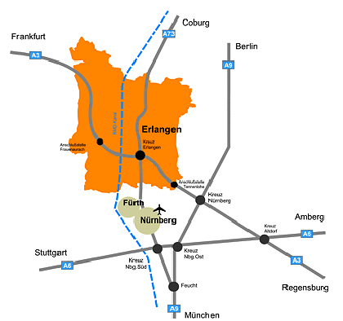
Location – Practical Aspects
Public transport: Most students and staff use public transport and/or bicycles within town, good connections by train to Nürnberg (15 min. and Fürth, 7 min.)
Next airport is in the North of Nürnberg, on the southern border of the city of Erlangen
33

Slide 34
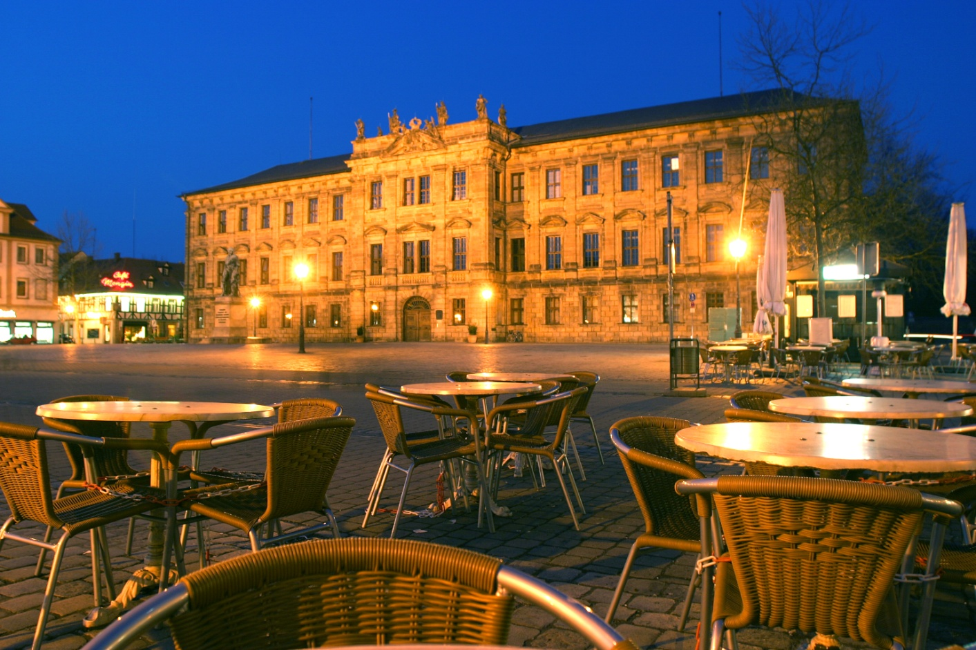

Slide 35

Thank you for your attention
contact: bianca.distler@fau.de

